Slide 1
Preparing and Presenting Research Results
MKTG 2341-09 Lecture Week 12

Slide 2
Announcements
Research report is due next Friday, December 4th, by noon.
Next week’s lecture will include a course review – make sure that you attend!
Student evaluations will be conducted next week during labs.

Slide 3
On to the lecture…

Slide 4
Learning Outcomes
Appreciate the importance of the marketing research report.
Understand the information to include in each section of the report.
Understand basic guidelines for writing effective reports.
Understand how to use headings and subheadings effectively.

Slide 5
Importance of the Research Report

Slide 6
The Marketing Research Report
Conveys the following:
Background & research objectives
Methodology
Research findings
Conclusions
Recommendations
Other important information

Slide 7
Importance of the Research Report
Most importantly, the client bases his/her decisions on the contents of the report.
The marketing research report is the product that represents the efforts of the marketing research team, and it may be the only part of the project that the client will see.

Slide 8
Importance of the Research Report
The time and effort expended in the research process are wasted if the report does not communicate the findings effectively.

Slide 9
Decisions Affected by Research
The BC Government changes course on public policy regarding minimum wage, wage parity, forest practices, health care, education…
Vancouver Parks and Recreation makes the decision to devote more of its budget to an under-served area of the City.
A tourism operator starts marketing to a completely different market.
A Chinese motorcycle manufacturer decides which models to introduce first in Canada.

Slide 10
Decisions Affected by Research
VanCity Credit Union decides which air carrier to partner with on its VISA card.
A real estate development and management company decides what benefits to offer employees.
Canfor decides how to market its 2 x 4’s in a commodity market.
BC Lotteries decides what features to include on its PlayNow website and how to market it to most effect.
Notes:
STOP: Ask students about how they think they might use marketing research in their own careers.

Slide 11
Content of the Research Report

Slide 12
Content of the Research Report
Marketing research reports are tailored to specific audiences and purposes.
You need to consider both in all phases of the research process, including planning the report.

Slide 13
Content of the Research Report
Things to consider:
The purpose of the study.
The audience.
The audience’s interests, values, concerns.

Slide 14
Content of the Research Report
Different things for different audiences:
Front line staff need to know what they should be doing on a day-to-day basis.
Managers want to know how the results affect their departments.
Upper management wants to know how to ‘steer’ the company.

Slide 15
Content of the Research Report
Three main sections:
Front matter
Body
End matter

Slide 16
1) Front Matter
Front matter: all of the pages that precede the first page of the report.

Slide 17
1) Front Matter
Front matter consists of:
Title Page
Table of Contents
Executive Summary
List of Illustrations

Slide 18
Front Matter: Title Page
The Title Page contains:
The title of the document
The organization/person(s) for whom the report was prepared
The organization/person(s) who prepared the report
The date of submission

Slide 19
Front Matter: Title Page
The Title Page contains:
The title of the document
The organization/person(s) for whom the report was prepared
The organization/person(s) who prepared the report
The date of submission

Slide 20

Front Matter: Title Page

Slide 21
Front Matter: Table of Contents
The Table of Contents helps the reader find information in the research report

Slide 22
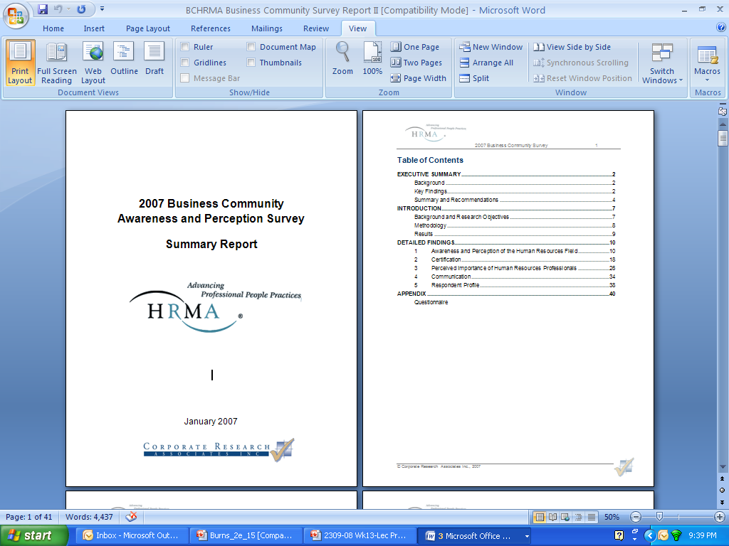
Front Matter: Table of Contents

Slide 23
Front Matter: Executive Summary
Very important – this cannot be overstated!
A ‘snapshot’ view of the research report.
What most people read.
Only those with specific needs tend to dig into the rest of the report.

Slide 24
Front Matter: Executive Summary
Includes the following:
Introduction and Background
Brief Methodology
Key Findings
Conclusions and Recommendations

Slide 25
Front Matter: List of Illustrations
All tables and figures should be included in this list by their respective titles.
Tables are words or numbers that are arranged in rows and columns.
Figures are graphs, charts, maps, pictures, and so on.

Slide 26
2) Body of the Report
This is the main section of the report and includes:
Introduction
Research Objectives
Methodology
Limitations
Key Findings
Conclusions

Slide 27
Body: Introduction
The introduction to the marketing research report.
Orients the reader to the contents of the report.

Slide 28
Body: Introduction
The introduction should contain:
statement of the background situation leading to the problem
clear statement of the research problem
summary description of how the research process was initiated

Slide 29
Body: Research Objectives
Research objectives, both general and specific, must be listed.

Slide 30
Body: Methodology
This section describes, in as much detail as necessary:
how you conducted the research, including the secondary, qualitative and quantitative research activities that took place
goal is to provide people with enough information to replicate the research, if necessary, in the future

Slide 31
Body: Methodology
Secondary Research information to include:
sources that were used
how information was collected, compiled and analyzed

Slide 32
Body: Methodology
Qualitative Research information to include:
type of research conducted – in-depth interviews and/or focus groups
types of individuals/target populations included in the research (but do not identify specific individuals)

Slide 33
Body: Methodology
Qualitative Research information to include:
when and where the interviews and/or focus groups were conducted (be very specific)
who conducted the research
products of the research (e.g., existence of audio/video tapes, etc.)

Slide 34
Body: Methodology
Quantitative Research information to include:
specifics of the type of survey research conducted: on-site, mail, online, telephone, etc.
types of individuals/target populations included in the research

Slide 35
Body: Methodology
Quantitative Research information to include:
description of the sample plan
sample size determination
how the data were analyzed
products of the research (e.g., questionnaire(s), hard and/or electronic copies of data files, etc.)

Slide 36
Body: Methodology
IMPORTANT:
It is convention within the marketing research industry that the methodology for the entire project be written up in one section and included in the body of the report.
However, for your project, you need to write separate methodologies for your secondary, qualitative and quantitative research and to include them in the relevant sections.

Slide 37
Body: Limitations
Do not attempt to hide or disguise problems in your research; no research is faultless.
Always be honest and open regarding all aspects of your research.

Slide 38
Body: Limitations
Typical limitations in research reports often focus on but are not limited to factors such as time, money, size of sample, availability of contact lists, and personnel.

Slide 39
Body: Key Findings (Results)
The results section:
is the most important (and largest) section of your report.
addresses, through text and/or tables and charts, each question on the questionnaire(s)

Slide 40
Body: Key Findings (Results)
The results section:
should logically present the findings of your research and be organized around the objectives of the study
Here’s an example from a recent ‘brand audit’ conducted for the School of Business…

Slide 41
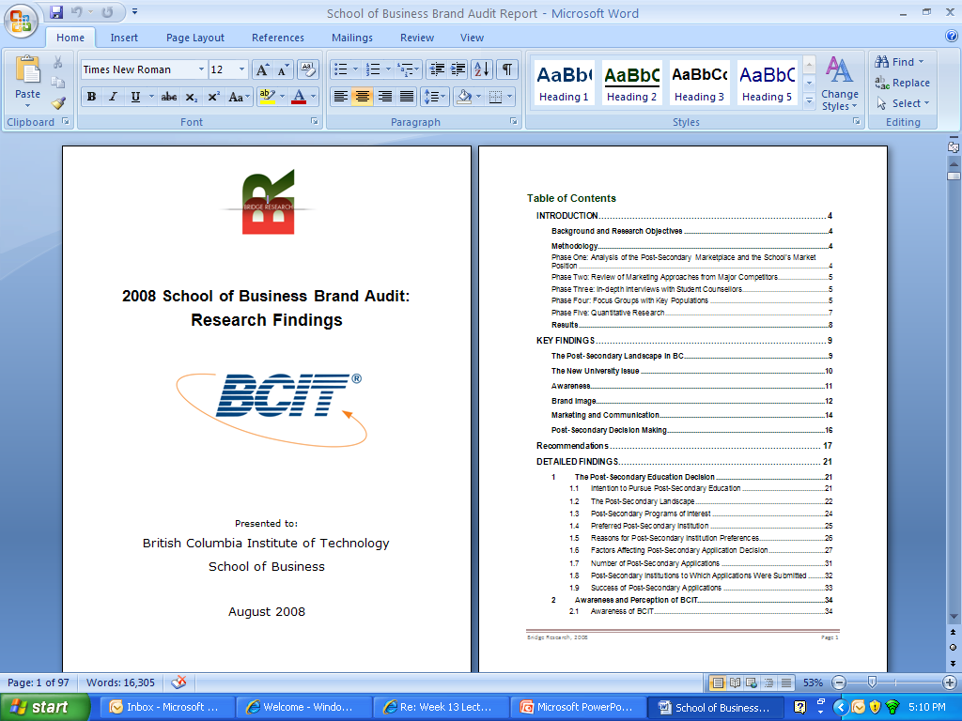
Here’s a major section, focusing on one of the major study objectives
And here are sub-sections, each of which addresses an aspect of this section’s theme

Slide 42
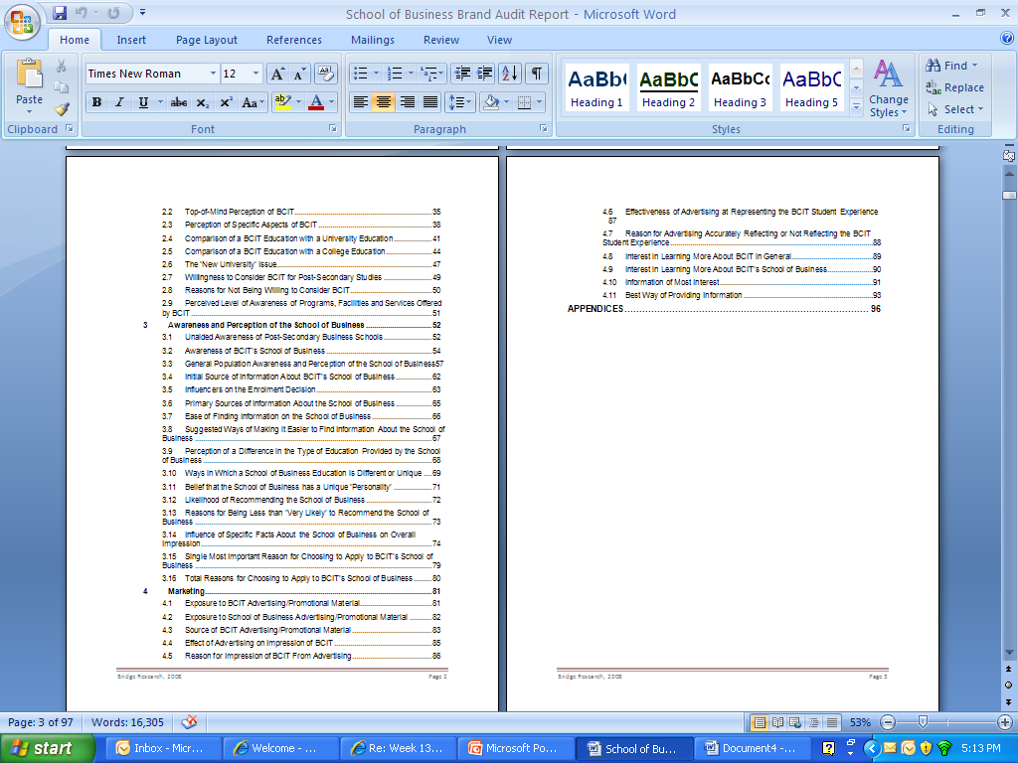
More major sections or ‘themes’.

Slide 43
Body: Key Findings (Results)
The results section:
should logically present the findings of your research and be organized around the objectives of the study
NOTE: do not ‘leave out’ findings even if you think that they are unimportant or uninteresting!

Slide 44
Body: Conclusions and Recommendations
Very important, this is what the client is paying you for!
Conclusions: are the outcomes and decisions you have reached based on your research results.
Recommendations: are suggestions for how to proceed based on the conclusions.

Slide 45
Body: Conclusions and Recommendations
Conclusions and recommendations may be listed together or in separate sections, depending on the amount of material you have to report.
They are usually reported in the Executive Summary as well.

Slide 46
Body: Conclusions and Recommendations
IMPORTANT!
Make sure that your conclusions are tied back to the research objectives.
Do not just summarize the Secondary, Qualitative, and Quantitative Research in three separate paragraphs.
Combine the findings into major conclusions drawing on all three types of research

Slide 47
Body: End Matter
The end matter:
contains information that the reader may need to refer to for further reading but that is not essential to reporting the data and includes:
Appendices
Endnotes

Slide 48
Body: End Matter
A reference page or endnotes should precede the appendix.
Appendices: contain the ‘nice to know’ information, not the ‘need to know’

Slide 49
Writing Effective Research Reports

Slide 50
Writing Effective Research Reports
A well written report
presents findings in an objective and easy to read and understand manner
flows logically from beginning to end
groups findings into common themes that are tied directly to research objectives

Slide 51
Writing Effective Research Reports
A well written report
is devoid of spelling, punctuation and grammar mistakes*
uses only enough words as necessary to convey its messages
makes effective use of visuals such as tables and charts to display findings
Notes:
*lack of care in writing up research findings makes the findings themselves suspect – if a researcher is careless in reporting findings, were they also careless in collecting the data? This applies not only to research reports but to every kind of business report.

Slide 52
Writing Effective Research Reports
A word on style
Stylistic devices can make the difference in whether or not your reader gets the message as you intended it
Some tips…
A good paragraph has one main idea.
Capitalize on white space.
Notes:
*lack of care in writing up research findings makes the findings themselves suspect – if a researcher is careless in reporting findings, were they also careless in collecting the data? This applies not only to research reports but to every kind of business report.

Slide 53
Reporting on Research Findings

Slide 54
Reporting on Research Findings
What to report…
Look first for strong, consistent trends in the data (e.g., purchase intention increases with respondents’ age).
When no trends are evident, report on largest and smallest percentages.

Slide 55
Reporting on Research Findings
What to report…
Statistically significant relationships found during cross-tabulation analyses.

Slide 56
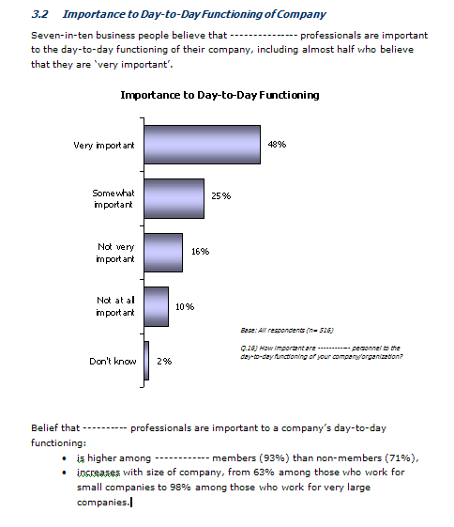
Reporting Example

Slide 57
Using Headings and Sub-Headings

Slide 58
Using Headings and Sub-Headings
Headings: indicate the topic of each section.
Subheadings: should divide that information into segments.

Slide 59
The End

